Slide 1


Slide 2
Introduction to Java

Slide 3
Introduction to Java
A programming language Fully buzzword-compliant:
A simple, object oriented, distributed, interpreted, robust, secure, architecture neutral, portable, high performance, multithreaded, dynamic language.
From: Java: An Overview
James Gosling, Sun Microsystems, February 1995.

Slide 4
Introduction to Java
According to Gosling:
“An environment”
“A platform”
“A way of thinking”

Slide 5
History of Java
1993 Oak project at Sun
small, robust, architecture independent, Object-Oriented, language.
1995 Oak becomes Java
Focus on the web
1996 Java 1.0 available
1997 (March) Java 1.1 - some language changes, much larger library, new event handling model
1997 (September) Java 1.2 beta – huge increase in libraries including Swing, new collection classes, J2EE
1998 (October) Java 1.2 final (Java2!)
2000 (April) Java 1.3 final
2001 Java 1.4 final
2004 Java 1.5 (parameterized types, enum, …) (Java5!)
2005 J2EE 1.5

Slide 6
Features of Java
Java is a general-purpose, high-level programming language.
The features of Java
Java program is both compiled and interpreted.
Write once, run anywhere
Platform independent.
Java Virtual Machine (Java VM)
The Java Application Programming Interface (JAVA API)

Slide 7
Features of Java
Simple
Architecture-neutral
Object-Oriented
Distributed
Compiled
Interpreted
Statically Typed
Multi-Threaded
Garbage Collected
Portable
High-Performance
Robust
Secure
Extensible
Well-Understood

Slide 8
Java Developer's Kit (I)
Java's programming environment
Core Java API
compiler
interpreter
debugger
dis-assembler
profiler
more...

Slide 9
Java Developer's Kit (I)
Java
Compiler
Java
Interpreter
Compile
Run
Java Source
Java Bytecode
<file>.java
Java
Dis-assembler
<file>.class
Notes:
Bytecode - low-level instructions that closely resemble machine code instructions, but they are intended to be executed by the Java Virtual Machine (JVM).

Slide 10
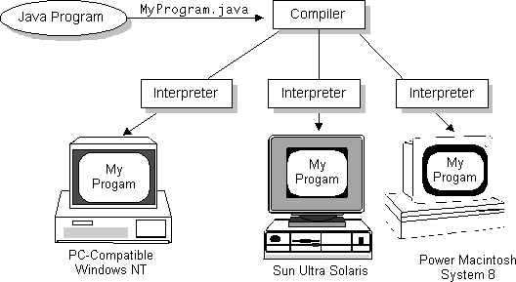
Write Once, Run Anywhere

Slide 11
ByteCode: Food for the VM
For most languages, compilation produces machine code
Java compilation produces “bytecode”
Intermediate code readable by the VM
Transferable across the Internet as applets
VM interprets BC into instructions
Partly responsible for performance lag
ByteCode produced on any platform may be executed on any other platform which supports a VM

Slide 12
execution model of Java
compiler
source
(text)
bytecode
(class file)
JVML
dynamic
loading
virtual machine
verifier
JIT
compiler
bytecode
interpreter
compiled
code
CPU

Slide 13
The JIT
Just-In-Time compiler
Translates bytecode into machine code at runtime
1-time overhead when run initiated
Performance increase 10-30 times
Now the default for most JVM’s
Can be turned off if desired
JIT can apply statistical optimizations based on runtime usage profile

Slide 14
Not just one JVM, but a whole family
JVM (J2EE & J2SE)
Well-known Java Virtual Machine.
CVM, KVM (J2ME)
Small devices.
Reduces some VM features to fit resource-constrained devices.
JCVM (Java Card)
Smart cards.
It has least VM features.
And there are also lots of other JVMs

Slide 15
References
1. https://docs.oracle.com/javase/8/docs/
2. Schildt, H. (2014). Java: the complete reference. McGraw-Hill Education Group.

Slide 16
THANK YOU

